Slide 1
Ecology Meets Epidemiology
E²M²: Ecological and Epidemiological Modeling in Madagascar
Centre ValBio
Ranomafana National Park, Madagascar
6 – 14 January, 2020

Slide 2

Thanks to our sponsors!

Slide 3

International Clinics on Infectious Disease, Dynamics, & Data

Slide 4
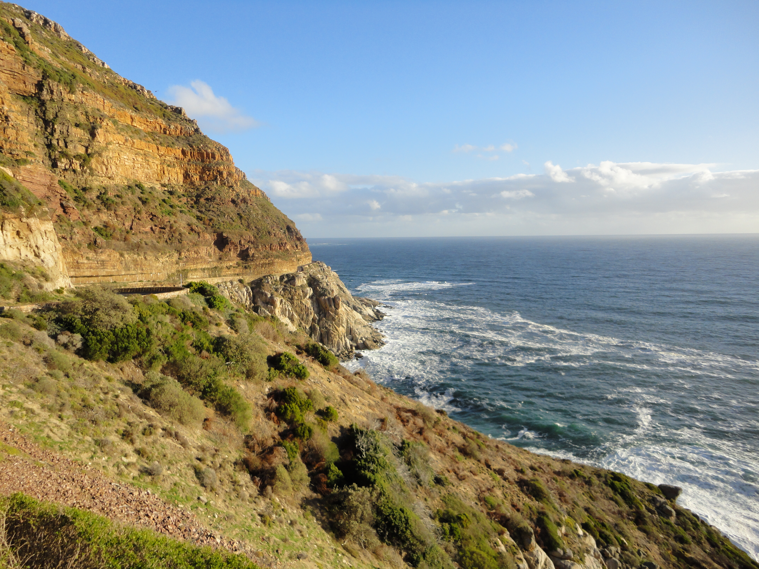
International Clinics on Infectious Disease, Dynamics, & Data
MMED: Clinic on the Meaningful Modeling of Epidemiological Data
May-June 2019, Cape Town, South Africa

Slide 5
International Clinics on Infectious Disease, Dynamics, & Data
MMED: Clinic on the Meaningful Modeling of Epidemiological Data
May-June 2020, Cape Town, South Africa
DAIDD: Clinic on Dynamical Approaches to Infectious Disease Data
December 2020, Stellenbosch, South Africa

Slide 6
International Clinics on Infectious Disease, Dynamics, & Data
MMED: Clinic on the Meaningful Modeling of Epidemiological Data
May-June 2020, Cape Town, South Africa
DAIDD: Clinic on Dynamical Approaches to Infectious Disease Data
December 2020, Stellenbosch, South Africa
South African Center for Epidemiological Modeling and Analysis (SACEMA), Director
Dr. Juliet Pulliam
University of Stellenbosch
ICI3D, Program Director
Dr. Steve Bellan
University of Georgia

Slide 7
International Clinics on Infectious Disease, Dynamics, & Data
www.ici3d.org

Slide 8
Goals for this lecture
To explain what we’re doing here

Slide 9
Goals for this lecture
To explain what we’re doing here
To introduce the “E” and the “M” in E²M²

Slide 10
Goals for this lecture
To explain what we’re doing here
To introduce the “E” and the “M” in E²M²
Ecology
Epidemiology

Slide 11
Goals for this lecture
To explain what we’re doing here
To introduce the “E” and the “M” in E²M²
Ecology
Epidemiology
Modeling
Madagascar

Slide 12
All course materials are available at:
E2M2.org

Slide 13
Saturday/Sunday: R Bootcamp
Intro to R Studio
Exploring and Visualizing Data in R
For-loops, Functions, and If-Else Statements
Data Cleaning
Intro to Spatial Visualization & Plotting
Thursday: “More Complicated Models”
● Intro to Mixed Modeling
● Mixed modeling in R
● Introduction to Occupancy Modeling
● Occupancy modeling in R
● Compartmental Modeling Extensions
● Intro to Network Modeling
● Model Telephone
● Programming
● Lectures
● Activities
● Research Development
Saturday: “Putting it All in Perspective”
● Modeling in Practice: The Lifecycle of a Modeling Project
● Mentor Research Presentations
● Looking Back
Monday: Travel
Tuesday: “Understanding Your System”
● Data and Models
● Reviewing Concepts in Mathematics
● Student Introductions & Presentations
● Formulating Research Questions
● Study Design and Data Collection
● Designing Studies in R
Friday: “Refining Your Work”
● Model Fitting – The Basic Concept
● Model Selection and Comparison
● Discussion of a scientific paper
● Epidemic Cards
● Model Fitting with Epidemic Cards
● Final research plans
● Research snapshots
Sunday: Travel
Tuesday: “Sharing Your Work”
● Final student presentations
Wednesday: “Building Simple Models”
● Linear Regression and Simple Statistics
● Statistical Modeling in R
● Dynamical Fever
● Intro to Compartmental Models
● Building Mechanistic Models in R
● Refining Research Questions for Modeling

Slide 14
Goals for this lecture
To explain what we’re doing here
To introduce the “E” and the “M” in E²M²
Ecology
Epidemiology
Modeling
Madagascar

Slide 15
Goals for this lecture
To explain what we’re doing here
To introduce the “E” and the “M” in E²M²
Ecology
Epidemiology
Modeling
Madagascar

Slide 16
What is an –ology?

Slide 17
What is an –ology?
“the study of”
“the science of”

Slide 18
What is an –ology?
“the study of”
“the science of”
goal: to explain

Slide 19
Goals for this lecture
To explain what we’re doing here
To introduce the “E” and the “M” in E²M²
Ecology
Epidemiology
Modeling
Madagascar

Slide 20
What is Ecology?

Slide 21
What is Ecology?
The study of the interactions of organisms and their environment

Slide 22
What is Ecology?
The study of the interactions of organisms and their environment
Herodotus (c. 425 BC): Nile crocodiles open mouths for sandpipers

Slide 23
What is Ecology?
The study of the interactions of organisms and their environment
Herodotus (c. 425 BC): Nile crocodiles open mouths for sandpipers
Term coined in 1866 by German scientist Ernst Haeckel

Slide 24
What is Ecology?
The study of the interactions of organisms and their environment
Herodotus (c. 425 BC): Nile crocodiles open mouths for sandpipers
Term coined in 1866 by German scientist Ernst Haeckel
Emphasis on explaining dynamical processes in nature

Slide 25
A Brief History of Ecology
Plant Biology
Clements (1905): ‘superorganism’
Gleason (1918): individualistic ecology

Slide 26
A Brief History of Ecology
Plant Biology
Clements (1905): ‘superorganism’
Gleason (1918): individualistic ecology
Population Biology
Charles Elton (1920s): food webs
Lotka-Voltera (1920s): predator-prey models

Slide 27
A Brief History of Ecology
Plant Biology
Clements (1905): ‘superorganism’
Gleason (1918): individualistic ecology
Population Biology
Charles Elton (1920s): food webs
Lotka-Voltera (1920s): predator-prey models
Mathematical Ecology
MacArthur (1950s): island biogeography

Slide 28
A Brief History of Ecology
Plant Biology
Clements (1905): ‘superorganism’
Gleason (1918): individualistic ecology
Population Biology
Charles Elton (1920s): food webs
Lotka-Voltera (1920s): predator-prey models
Mathematical Ecology
MacArthur (1950s): island biogeography
Disease Ecology
Anderson and May (1980s)
γ
S
βI or
βI/N
I
R
Susceptible
Infectious
Recovered

Slide 29
Goals for this lecture
To explain what we’re doing here
To introduce the “E” and the “M” in E²M²
Ecology
Epidemiology
Modeling
Madagascar

Slide 30
What is Epidemiology?

Slide 31
What is Epidemiology?
“the study of what is on the people”

Slide 32
What is Epidemiology?
“the study of what is on the people”
– coined by Spanish physician Villalba in 1802

Slide 33
What is Epidemiology?
“the study of what is on the people”
– coined by Spanish physician Villalba in 1802
Emphasis on the study and analysis of the distribution and determinants of health and disease (“risk factors”)

Slide 34
A Brief History of Epidemiology
Four Humors: HippoSickness caused by an imbalance in the four humors (c. 400 B.C.Hippocrates)
Four Humors
Disease results from imbalance
Hippocrates (c. 400 BC)

Slide 35
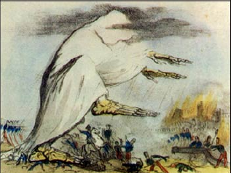
A Brief History of Epidemiology
Four Humors: HippoSickness caused by an imbalance in the four humors (c. 400 B.C.Hippocrates)
Four Humors
Disease results from imbalance
Hippocrates (c. 400 BC)
Miasmatic Theory of Disease
Disease results from emanations of ‘bad air’
Galen (140 AD)

Slide 36
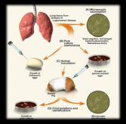
A Brief History of Epidemiology
Four Humors: HippoSickness caused by an imbalance in the four humors (c. 400 B.C.Hippocrates)
Four Humors
Disease results from imbalance
Hippocrates (c. 400 BC)
Miasmatic Theory of Disease
Disease results from emanations of ‘bad air’
Galen (140 AD)
Germ Theory of Disease
Disease results from ’germs’
Leeuwenhoek’s microscope (1675)
Koch’s postulates (1890)

Slide 37
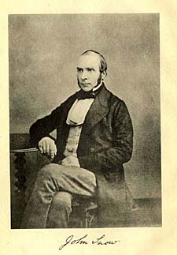
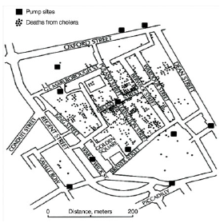
A Brief History of Epidemiology
Four Humors: HippoSickness caused by an imbalance in the four humors (c. 400 B.C.Hippocrates)
Four Humors
Disease results from imbalance
Hippocrates (c. 400 BC)
Miasmatic Theory of Disease
Disease results from emanations of ‘bad air’
Galen (140 AD)
Germ Theory of Disease
Disease results from ’germs’
Leeuwenhoek’s microscope (1675)
Koch’s postulates (1890)
Classical epidemiology
‘Risk factors’
John Snow and London cholera (1854)

Slide 38
Applying Ecology and Epidemiology
Applied Ecology = Conservation Biology
Goal: protect populations from extinction

Slide 39
Applying Ecology and Epidemiology
Applied Ecology = Conservation Biology
Goal: protect populations from extinction
Approach: protected area reserves

Slide 40
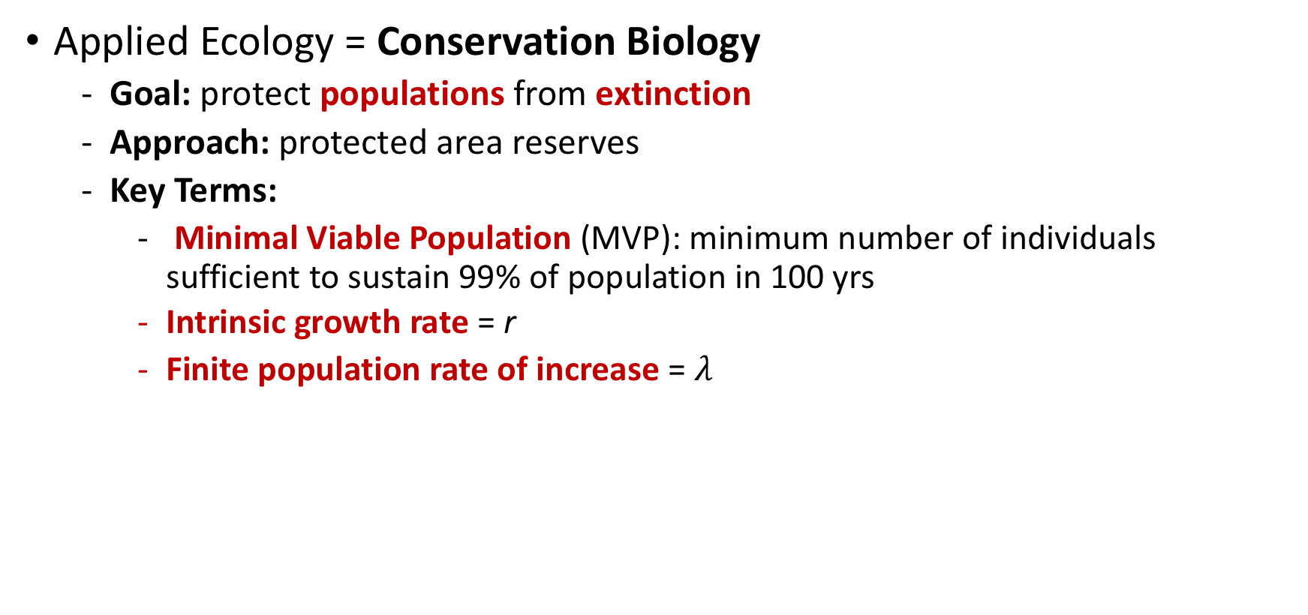
Applying Ecology and Epidemiology
Applied Ecology = Conservation Biology
Goal: protect populations from extinction
Approach: protected area reserves
Key Terms:
Minimal Viable Population (MVP): minimum number of individuals sufficient to sustain 99% of population in 100 yrs
Intrinsic growth rate = r
Finite population rate of increase = $λ$

Slide 41
Applying Ecology and Epidemiology
Applied Epidemiology = Public Health
Goal: protect populations from disease via pathogen extinction

Slide 42
Applying Ecology and Epidemiology
Applied Epidemiology = Public Health
Goal: protect populations from disease via pathogen extinction
Approach: sanitation, quarantine, vaccination

Slide 43
Applying Ecology and Epidemiology
Applied Epidemiology = Public Health
Goal: protect populations from disease via pathogen extinction
Approach: sanitation, quarantine, vaccination
Key Terms:
Critical Community Size (CCS): minimum number of hosts sufficient to sustain a pathogen indefinitely
Basic Reproduction Number = R₀

Slide 44
Goals for this lecture
To explain what we’re doing here
To introduce the “E” and the “M” in E²M²
Ecology
Epidemiology
Modeling
Madagascar

Slide 45
Misaotra!

